Slide 1
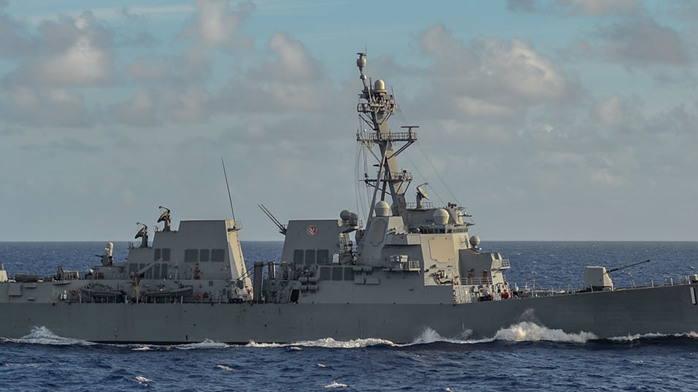
Huntington Ingalls Industries Inc
Long Idea
Price: $236.75
Last Price Date: 11/17/2023
Huntington Ingalls is a U.S. defense contractor with an emphasis on shipbuilding.

Slide 2
Table of Contents
1. Brief Overview of Business Segments and Most Recent Earnings
2. Financial Comps
3. Earning Call Highlights
4. Systematic Factor Back Test
5. Long Only Systematic
6. HII Factor Exposures
7. Code

Slide 3

Business Segments

Slide 4
Segments – Brief Overview
Newport News (~55%)
Constructs nuclear subs and aircraft carriers
Ingalls (~23%)
Non-nuclear ships for the USN and USCG
Amphibious assault ships, national security cutters, and warfare ships
US DoD Arleigh Burke-class destroyer awarded to HII and GD ($185Mn)
Mission Technologies (~22%)
Tech products and solutions to government and commercial markets
$1.6Bn in bookings for 3Q means more than 20% sequential backlog growth
Mission Tech YTD topline growth of 10% is in line of management’s $2.55Bn guide

Slide 5
3Q23 Earnings
$50mn bump to mid-point top line guidance
Driven by strength at Ingalls
US DoD Arleigh Burke-class destroyer awarded to HII and GD ($185Mn)
CF Guidance raised to $500mn (400-450mn prior)
$75mn pulled forward into 2023
Strong demand outlook for shipbuilding and Mission Technologies
Mission Tech YTD topline growth of 10% is in line of management’s $2.55Bn guide
$1.6Bn in bookings for 3Q means more than 20% sequential backlog growth
Continuing to de-lever allowing more cash to be returned to shareholders

Slide 6
Financials vs Comps

Slide 7
Financials vs Competitors
Trades at discount with relatively low expenses that has been deleveraging
Produces free cash flow that surpasses almost all defense contractors
Specializes in shipbuilding that will continue to win contracts as the Navy seeks an entirely new fleet more geared towards unmanned ships
From Navy F24 Budget Request Briefing
Navy has an aging fleet with new geopolitical risks in different parts of the world
“We are at an inflection point, with critical choices to make to meet the pacing challenge posed by the People's Republic of China, the acute threat of Russia, as well as the persistent threats of Iran, North Korea and other malign actors.” ~ Erik Raven
The F.Y. '24 president's budget request is $255.8 billion. This is an $11 billion, or 4.5 percent increase above our recently-enacted F.Y. '23 budget.

Slide 8
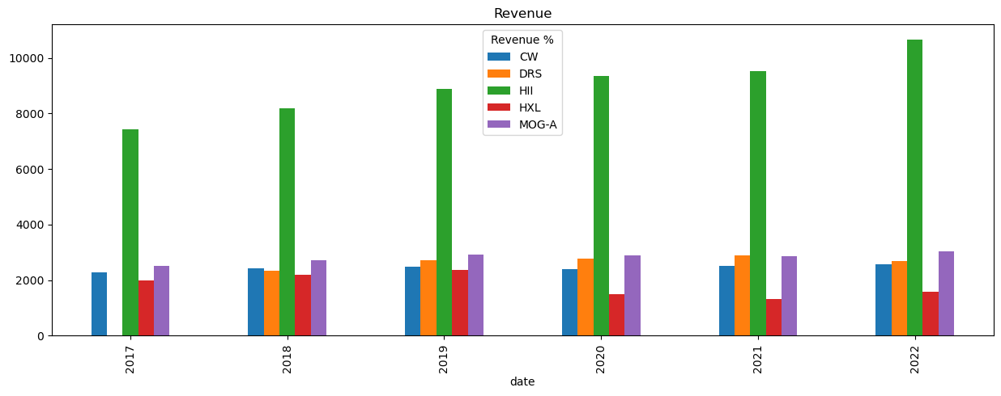
Steadily Growing Top Line

Slide 9
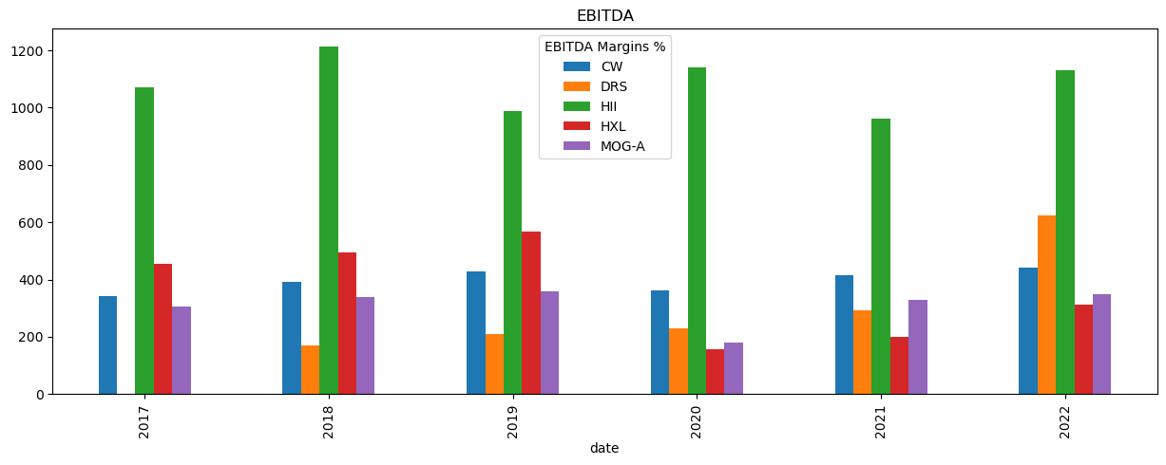
EBITDA - Annual Comparison

Slide 10
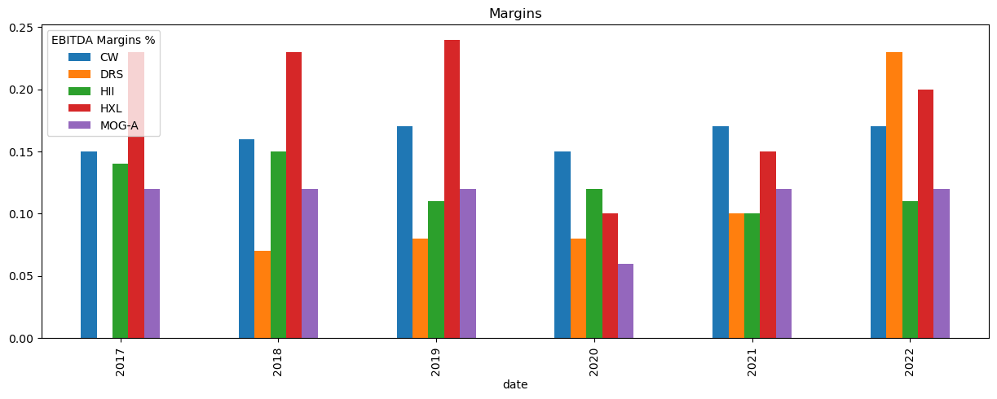
Margins - Consistent

Slide 11
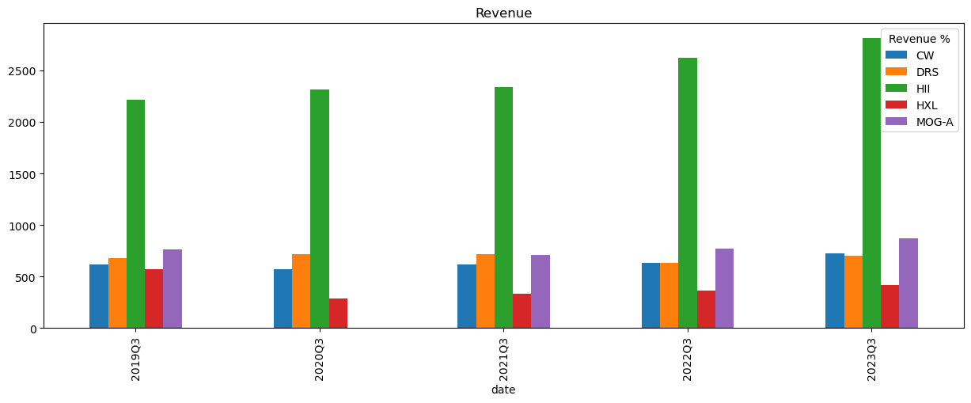
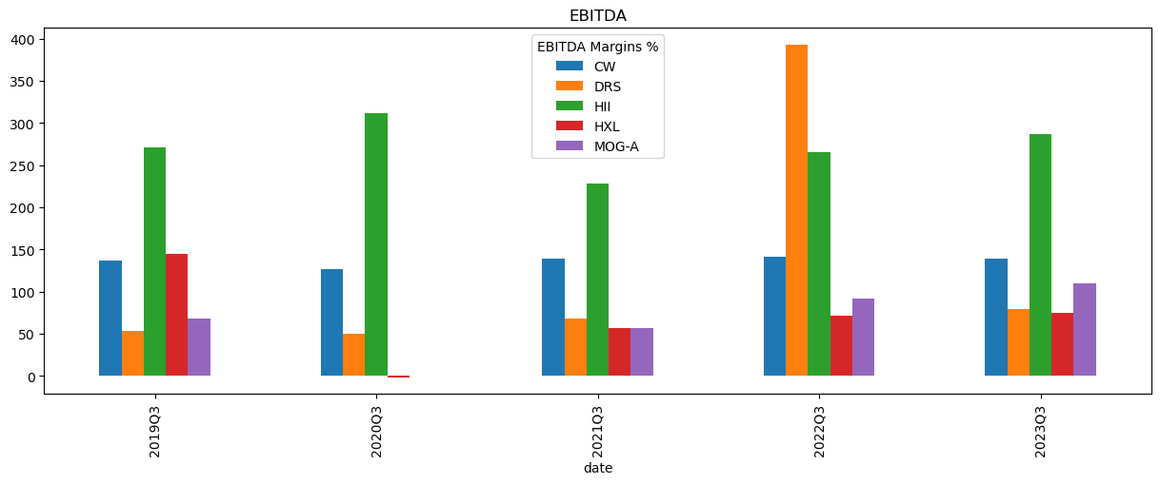
Quarterly Low Volatility of Top-Line and EBITDA

Slide 12
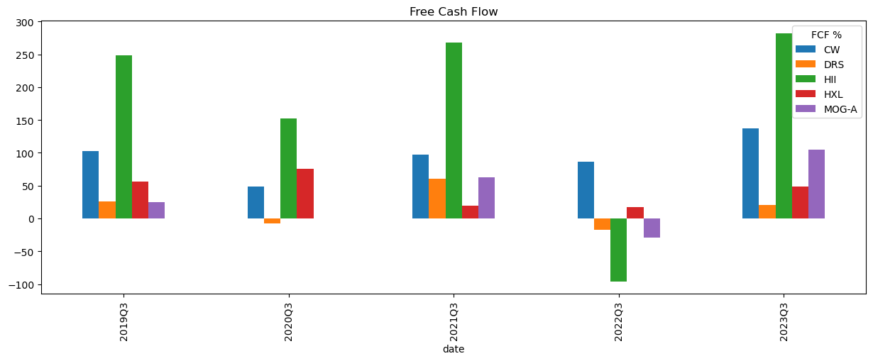
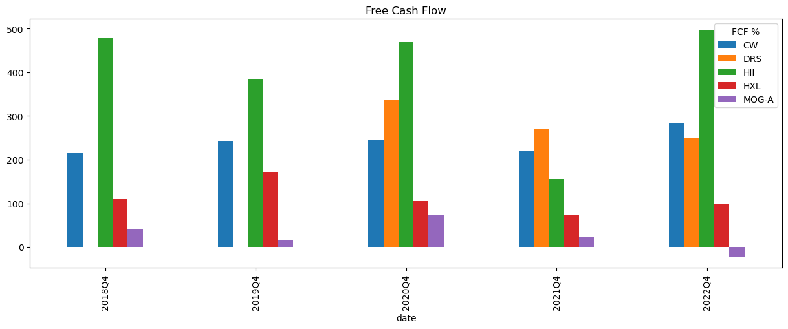
Free Cash Flow

Slide 13
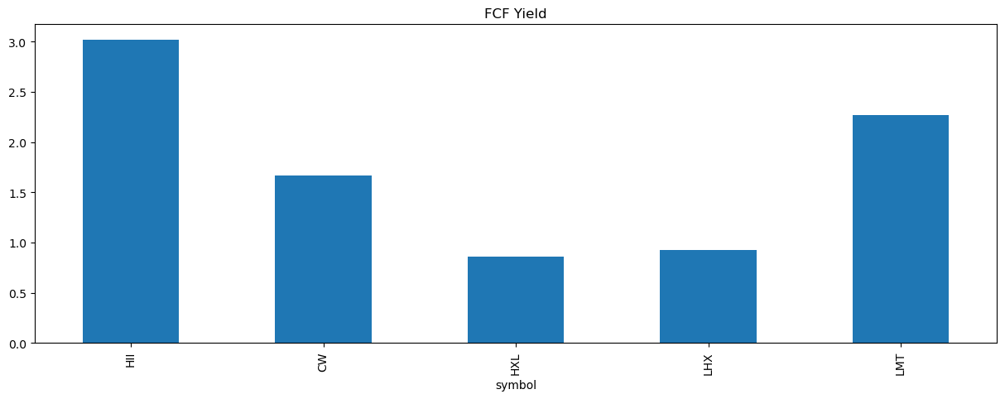
Free Cash Flow Yield (11/17/2023)

Slide 14
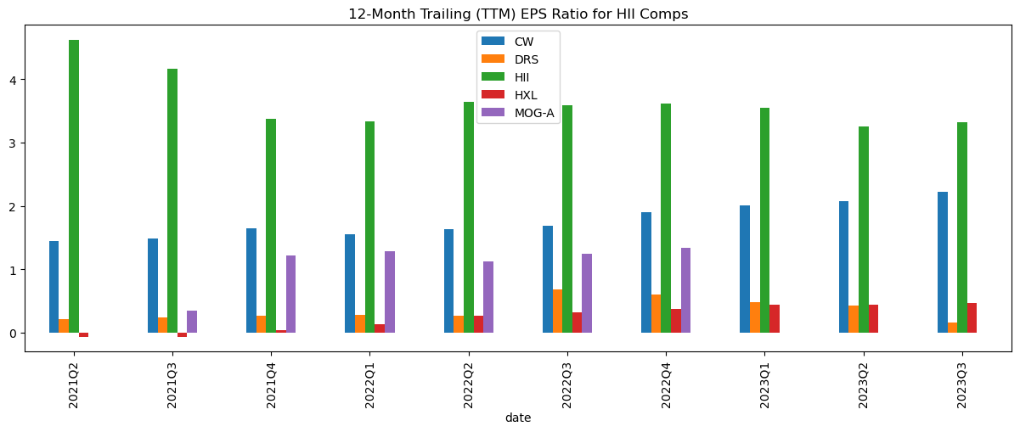
EPS TTM

Slide 15
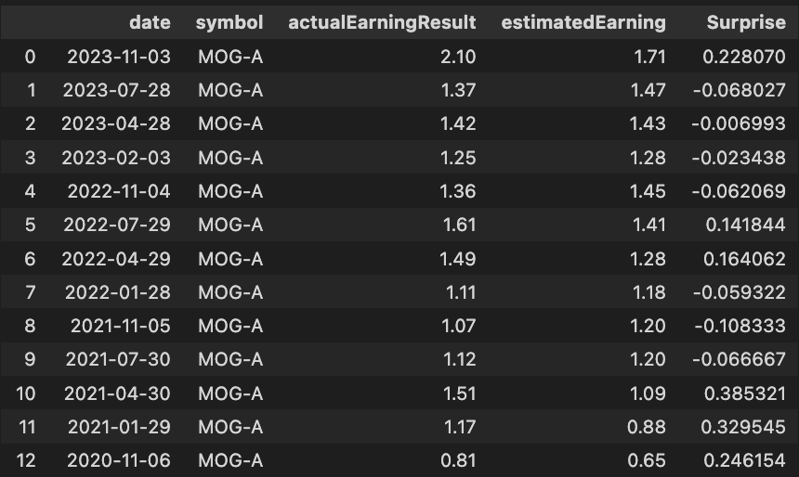
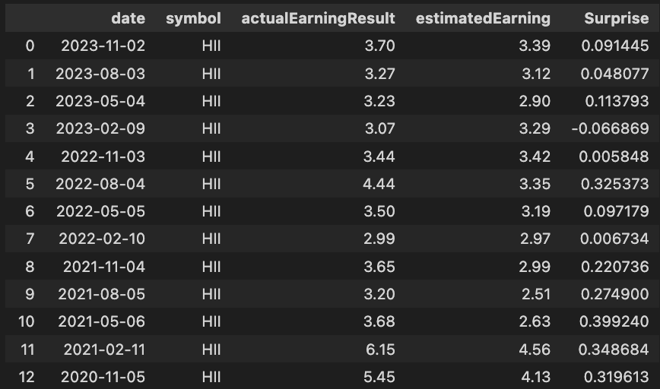
Earnings Surprises
HII has consistently met or exceeded EPS street consensus
Beat 12 out of last 13 Earnings
Compared to Moog Inc
Beat 6 out last 13

Slide 16
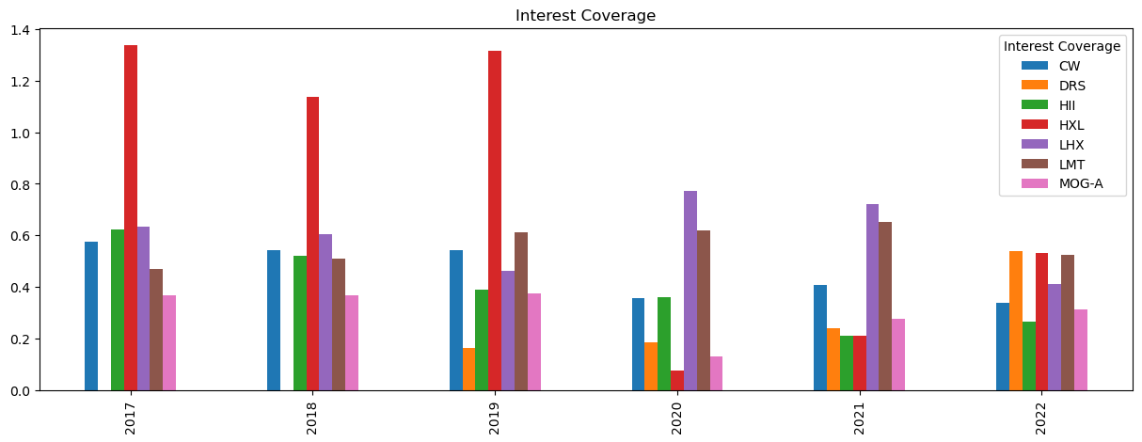
Low Interest Coverage - Higher for Longer

Slide 17
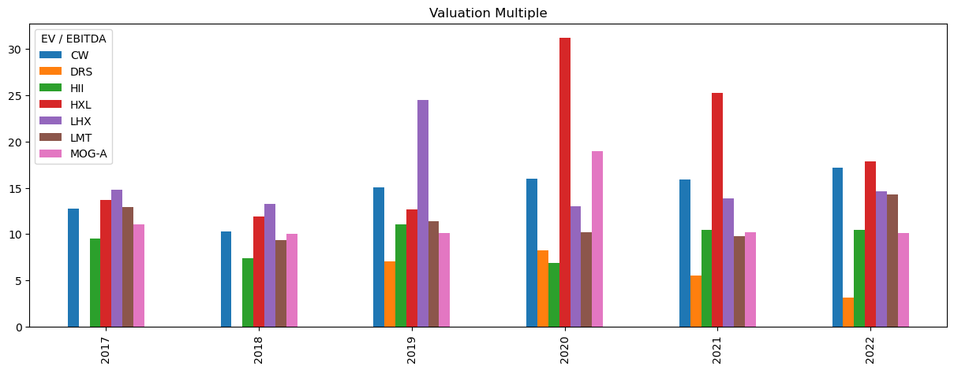
Cheaper Multiple

Slide 18
Most Recent Earnings Call Highlights

Slide 19
3Q23 Earnings Call – Main Highlights
Main Financial Highlights
YTD revenue growth of 5.3%
Increased guidance on revenue and free cash flow for FY23
Strong third-quarter revenue growth across all divisions.
Record 3Q Revenue of $2.8 Billion
Diluted EPS of $3.70
Backlog and Shipbuilding Milestones:
New contract awards of $5.4 billion, resulting in a backlog of approximately $49 billion (future revenue).
Successful shipbuilding milestones, including the launch of amphibious assault ship LHA 8 Bougainville and keel laying for LHA 9 Fallujah.
Various achievements at Ingalls, Newport News, and Mission Technologies divisions.
Notable contracts, including the modernization of USS Zumwalt DDG 1000 and awards for Arleigh Burke-class destroyers.
Describes the quarter as strong, showcasing progress in executing backlog and driving growth in Mission Technologies.
Mission Technologies Division:
Third straight quarter of record revenue at $685 million.
Mission Technologies showcased a backlog book-to-bill of 2.4 and a potential total contract value of over $5 billion year-to-date.
Significant contract wins, totaling over $5 billion in potential contract value year-to-date.

Slide 20
3Q23 Earnings Call: Main Segment Highlights
Government Funding and Congressional Expectations:
Express anticipation for Congress to proceed swiftly on appropriations for the second Columbia-class nuclear submarine construction.
Look forward to Congress finalizing the fiscal year 2024 National Defense Authorization Act, emphasizing support for shipbuilding and national security priorities.
Huntington Ingalls discussed the construction of the second Columbia-class submarine and emphasized the need for strong congressional support for shipbuilding.
Huntington Ingalls is eager to start constructing the second Columbia-class nuclear submarine and is hopeful for timely appropriations from Congress. They emphasize the importance of strong congressional support for shipbuilding and national security priorities
Newport News: Submarine Mix and Columbia-Class Impact:
Columbia-class, while important, represents only 22% to 23% of the work at Newport News.
The mix between Columbia-class and Virginia-class submarines doesn't dictate Newport News' margin performance, which is influenced more by Virginia-class program performance.
Newport News met its goal of 7.4% margin for the quarter.
Financial Results by Tom Stiehle:
Consolidated revenues of $2.8 billion, a 7.2% increase from the previous year.
Operating income increased by 31% to $172 million, with a margin of 6.1%.
Net earnings were $148 million, and diluted earnings per share were $3.70.
Cash from operations was $335 million, and free cash flow was $293 million.

Slide 21
3Q23 Earnings Call Highlights: Guidance
Free Cash Flow and Guidance:
An increase of $75 million in the fiscal year '23 free cash flow guidance, primarily due to the conclusion of negotiations on COVID advances and positive cash flow contributions for Mission Technologies.
Anticipation of distributing substantially all free cash flow to shareholders through 2024 after planned debt repayment.
Timing-driven changes in free cash flow, with receipts flowing sooner than expected.
The company expressed confidence in future growth prospects, with an expected inflection point in both shipbuilding and Mission Technologies.
Focus on working capital improvement, with positive performance in Mission Technologies contributing to topline and cash collections.
Increase in 2023 free cash flow guidance from good performance in Mission Technologies and navigating through COVID repay.
2024 free cash flow guidance remains at $700 million, reflecting timing dynamics and performance considerations.
Revenue Guidance Increase:
Shipbuilding revenue guidance midpoint increased by $50 million, ranging from $8.5 billion to $8.6 billion.
Mission Technologies revenue guidance increased by $50 million, reaching approximately $2.55 billion.
Reaffirmation of shipbuilding and Mission Technologies margin guidance.
Shipbuilding Margin Outlook for 2024:
Expected incremental improvement in shipbuilding margins in 2024.
Focus on transitioning from Block IV to Block V and continuous improvement in Newport News.
Recognition of large milestones in Q4 contributing to margin improvement.

Slide 22
Systematic Factors – Quick Back Test

Slide 23
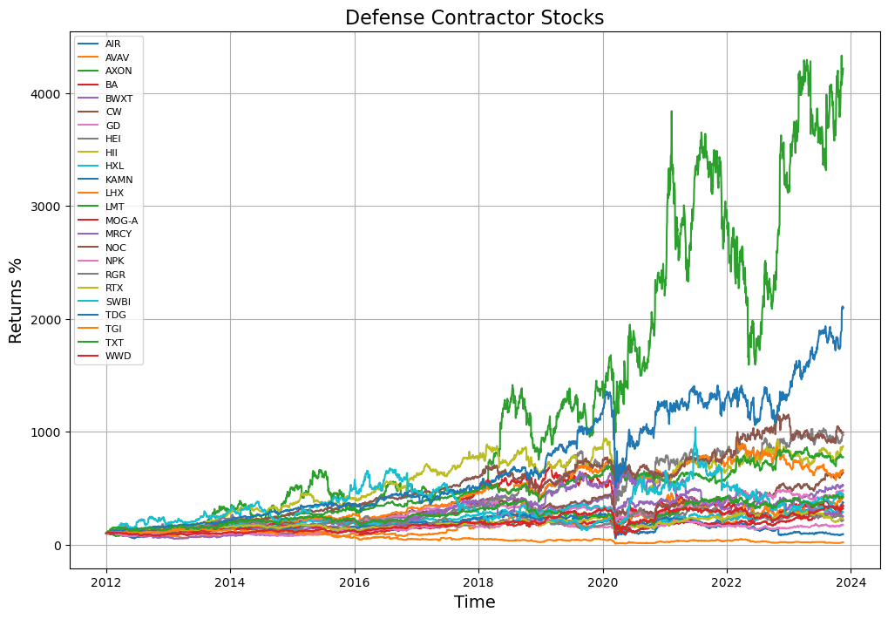
Systematic - Factors (2012-Present Day)
Quick back test of 24 Defense Contractors and Comparable Industrials companies using data from SEC Edgar (back from 2012)
Python Script provided in Appendix

Slide 24
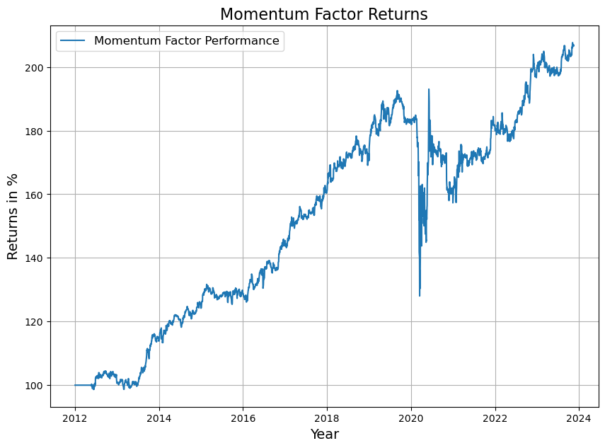
Momentum
Hurst Exponent
Long the 100-day Rolling Window Hurst greater than 0.55
Over 0.55 means a trending stocks (persistent price increase)
Short the Hurst less than 0.45
Under 0.45 means the stock is not trending up and is mean-reverting
Stocks with a persistent trend outperform mean reverting price action
Single Factor shows a high MDD during the COVID shock

Slide 25
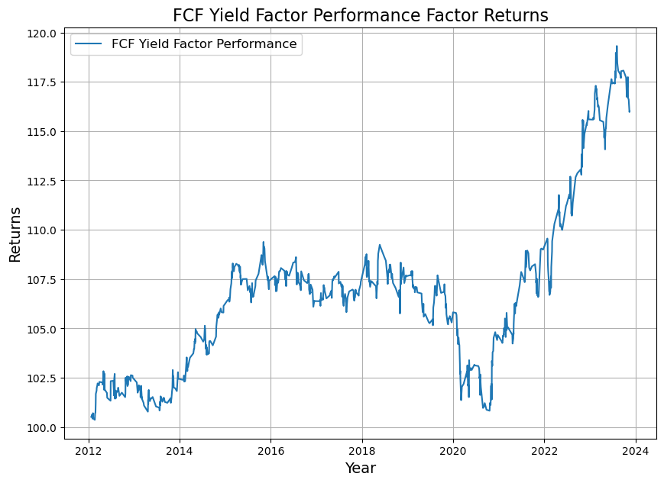
Free Cash Flow Yield
FCF Yield
Long companies in the 60th percentile FCF Yield
High FCF yield means companies are producing a lot of cash relative to their market capitalization
Short companies in the 40th Percentile
Low FCF yield might mean a company that is overvalued in proportion to cash flow production
Defense Contractor companies that are undervalued have outperformed since 2012
Single Factor shows high yielding companies outperform especially during the era where the central bank was pumping large amounts of liquidity into the market (post-covid)

Slide 26
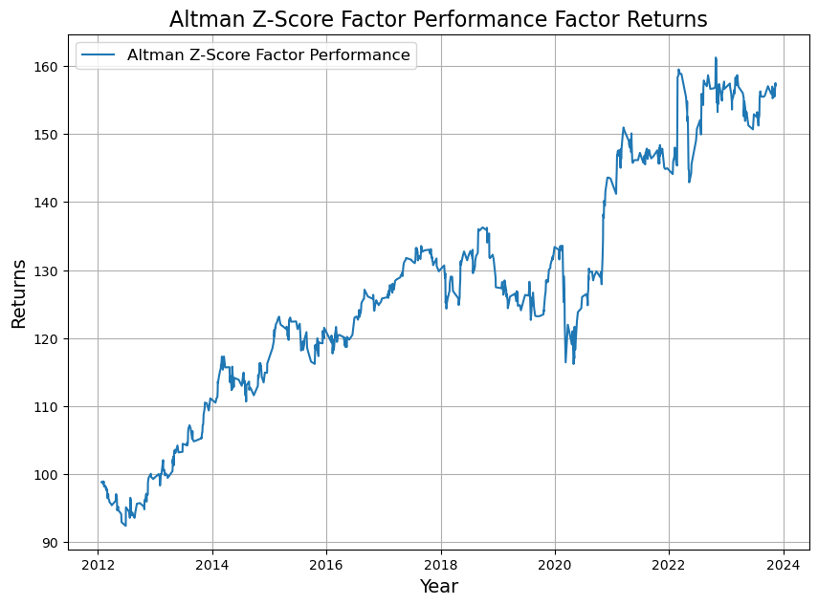
Altman Z-Score
Common credit risk score
Companies with a higher Z-Score on average have better credit than lower Z-Scores
Long Companies with Average to High Altman Z-Scores
Short companies with Altman Z-Scores lower than 1.00
Low relative Altman Scores mean
Defense Contractor companies that are undervalued have outperformed since 2012
Single Factor shows companies with higher working capital, more reinvestment into total assets, higher earnings to total assets, less leverage, and higher asset turnover outperform on average since 2012

Slide 27
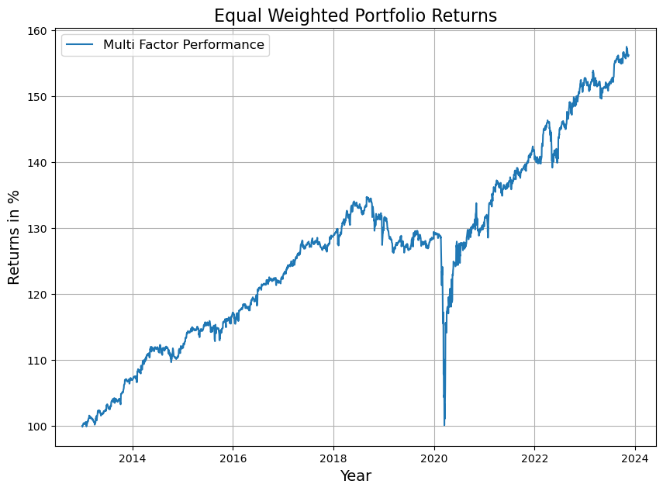
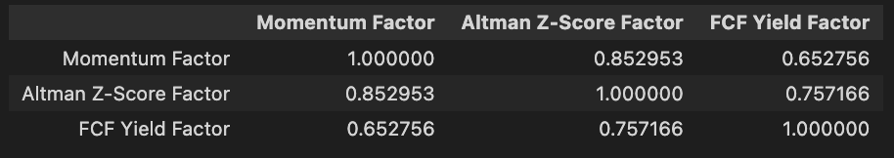
Equal Weighted: Altman Z-Score, FCF Yield & Momentum Factors
Each factor was equally weighted
Momentum Hurst > 0.55 minus Hurst < 0.45
FCF Yield 60th Percentile minus FCF Yield 40th Percentile
Altman Z Score > 1.00 minus Z-Score < 1.00
Altman Z Score was very correlated to the other two factors, so it won’t be used in the analysis going forward

Slide 28
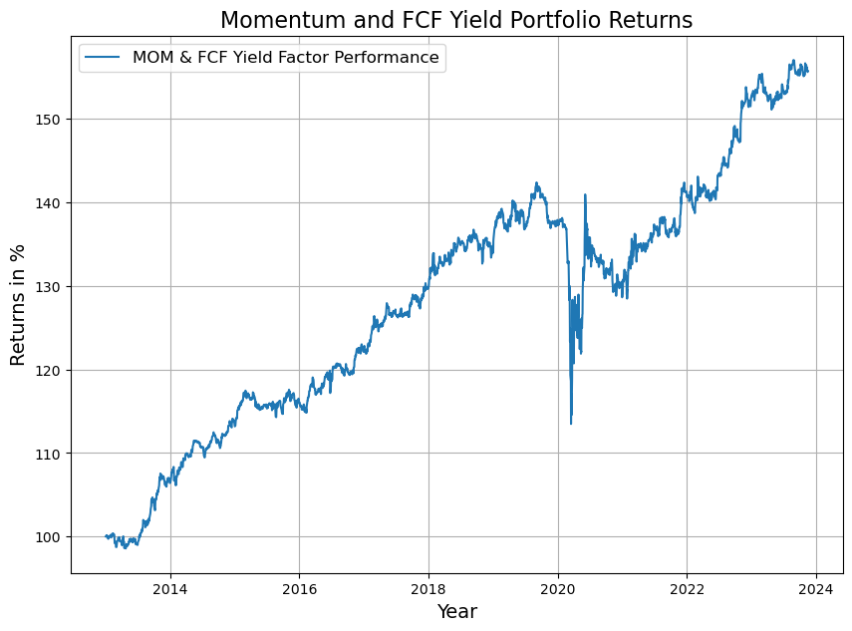
Equal Weighted: FCF Yield & Momentum Factors
High Altman Z-Score minus Low Altman Z-Score
High FCF Yield minus Low FCF Yield
Equal Weighted factors portfolio outperforms with a smaller drawdown

Slide 29
Systematic Long Only – Quick Back Test

Slide 30
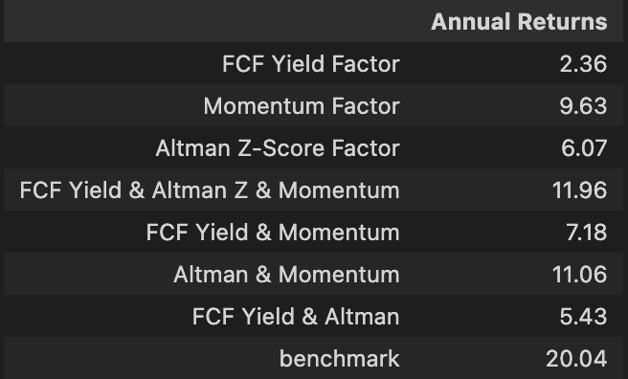
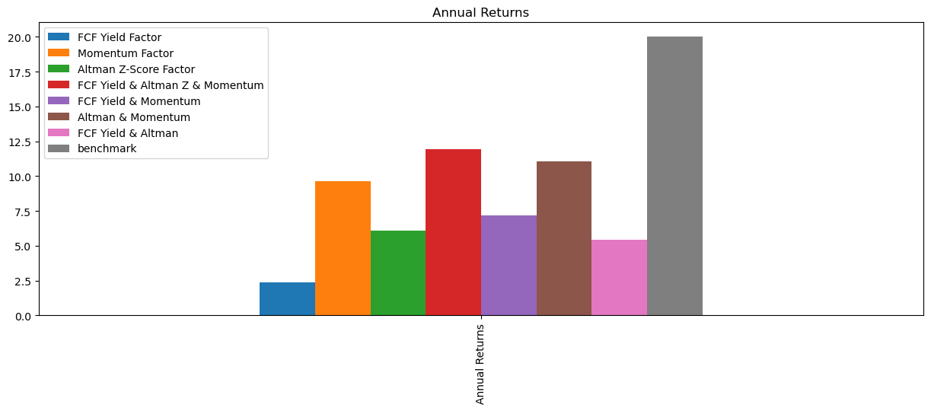
Annual Returns

Slide 31
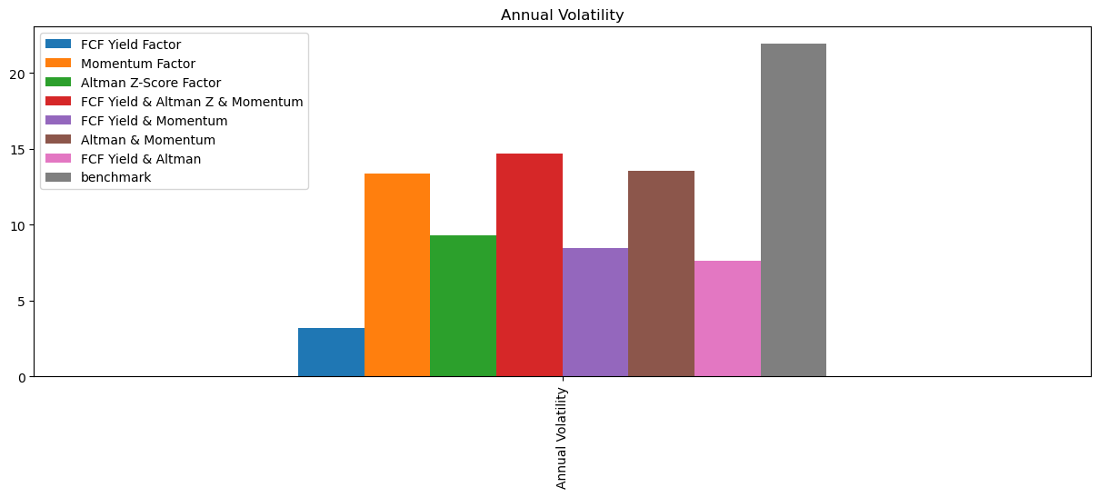
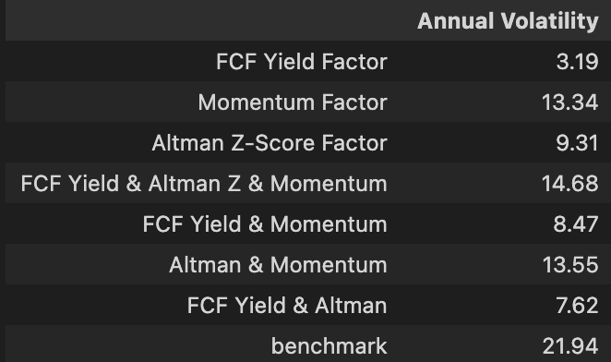
Volatility

Slide 32
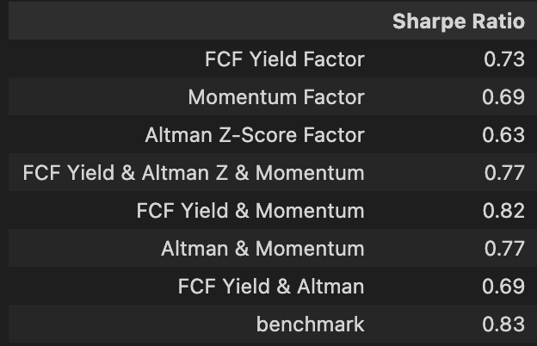
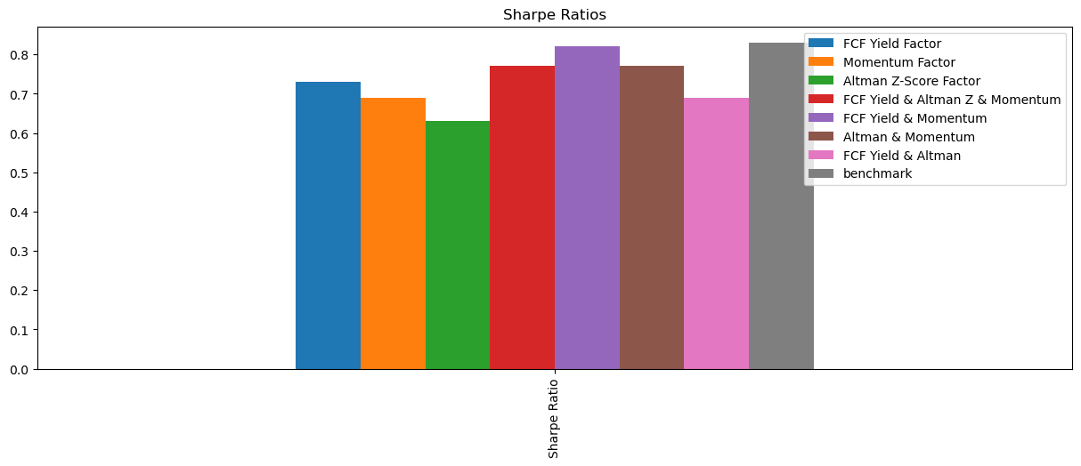
Sharpe Ratio

Slide 33
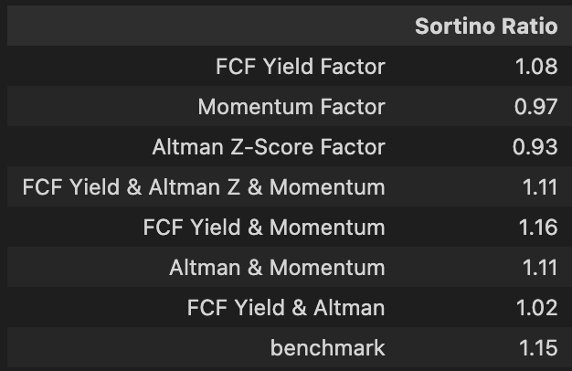
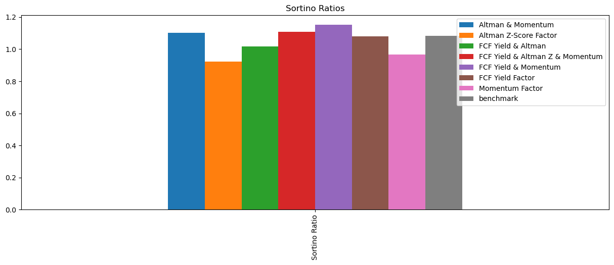
Sortino Ratio

Slide 34
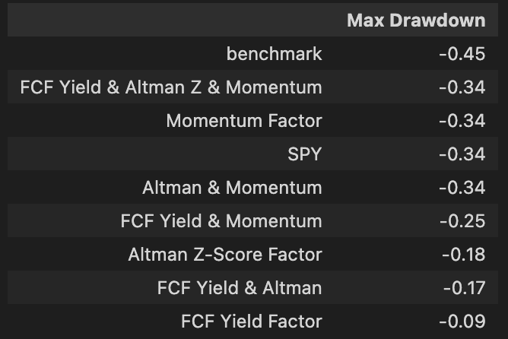
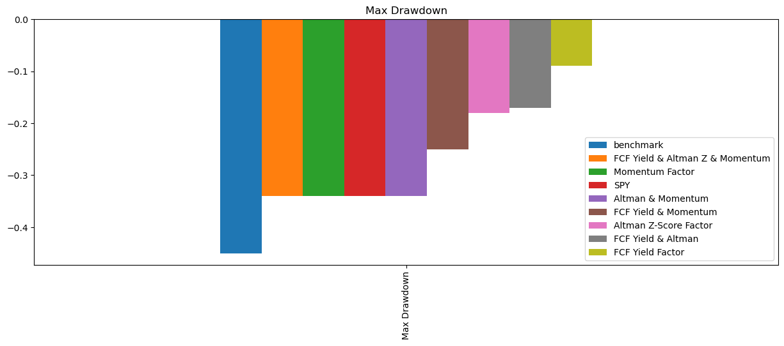
Maximum Drawdown

Slide 35
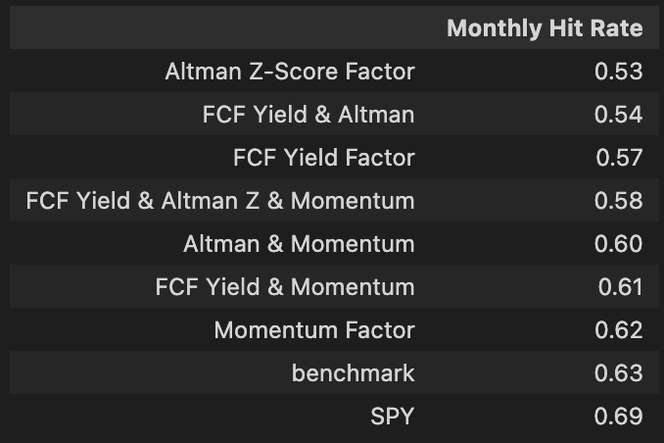
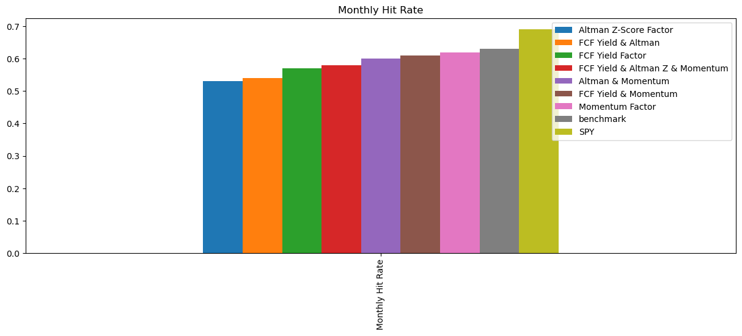
Hit Rate

Slide 36
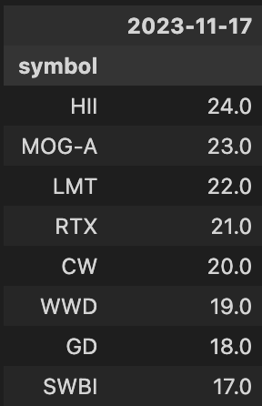
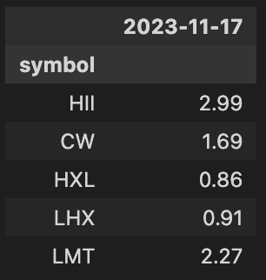
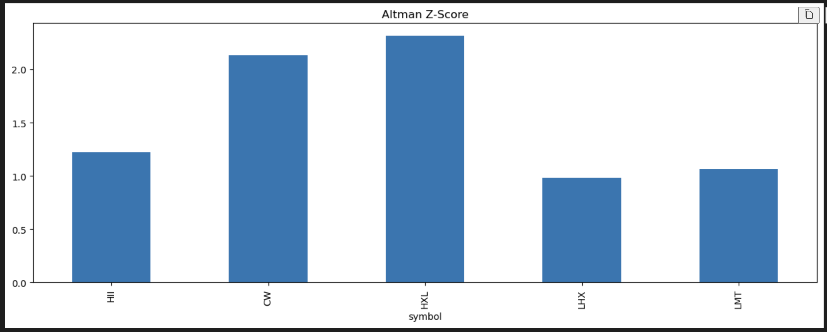
HII Factor Exposures
FCF Yield: 2.99 (ranked out of 24) – Highest FCF Yield among Ext. Peers
Momentum: 0.57 (over 0.55) – Ranked 17 out of 24 (71st percentile)
Altman Z-Score: 1.22 (Over 1.00) – Ranked 9th out of 24 (37.5th percentile)

Slide 37
Code
HII Systematic Code:
https://github.com/RyanFineganTradingProjects/2023-11-27-Trades/blob/main/QD%20Trading%20Strat%20HII.ipynb

